Slide 1
ECED3901 Design Methods II
Lecture #3: Project Management
Colin O’Flynn

Slide 2
What are we covering?
Project Design moving to Project Management
Making a realistic schedule
Issues hampering your project:
Legal
Compliance

Slide 3
Example: Mailing 500 Items
Q: I need you to mail out 500 boxes. I have a printed list of addresses. The boxes are all uniform size, but you will need to print labels/postage using a web service.
How long will this take?

Slide 4
Solving this…
Getting box, folding out:
Getting widget from stores:
Adding padding:
Taping box:
Printing postage / labels:
Total:

Slide 5
Solving this…
Getting box, folding out: 45 seconds
Getting widget from stores: 15 seconds
Adding padding: 45 seconds
Taping box: 30 seconds
Printing postage / labels: 120 seconds
Total: 4.25 min/box
4.25 * 500 = 2125 mins
2125 / 60 = 35 hours(!)

Slide 6

Kickstarter Project Management

Slide 7
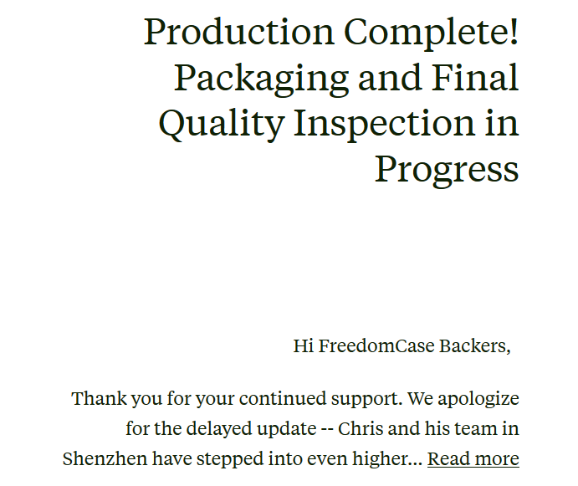
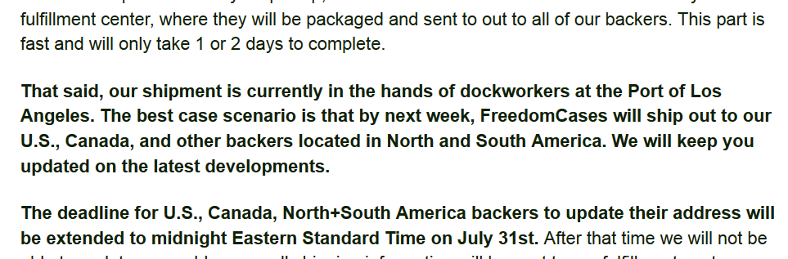
Kickstarter Project Management
…this one isn’t too bad, many more outright failures or huge delays, all due to project management issues

Slide 8
Project Management
Your amazing project WILL FAIL without some form of project management.

Slide 9
Project Management 101
Generate a “Work Breakdown Structure” (WBS)
WBS breaks down our larger task into manageable chunks (deliverables)
WBS is *not* a schedule
WBS is done recursively until we reach a reasonable level of detail
Take WBS, turn it into a schedule
Estimate/determine time for each lower-level task
Chain tasks together, determine interconnection
Use graph if you want for this last step (the infamous Gantt chart)

Slide 10
Work Breakdown Structure
0.0 Going on a hike

Slide 11
Work Breakdown Structure
0.0 Going on a hike
1.0 Scheduling / Planning
2.0 Executing the Hike
3.0 Finishing the Hike

Slide 12
Work Breakdown Structure
0.0 Going on a hike
1.0 Scheduling / Planning
1.1 Confirm when Carl is free
1.2 Print/Buy Maps
1.3 Pack
2.0 Executing the Hike
2.1 Drive to Location
2.2 Hike
2.3 Drive home
3.0 Finishing the Hike
3.1 Shower
3.2 Wash Clothing
3.3 Call mom

Slide 13
→Assign Tasks
0.0 Going on a hike
1.0 Scheduling / Planning
1.1 Confirm when Carl is free – Me
1.2 Print/Buy Maps – Carl
1.3 Pack – Me
2.0 Executing the Hike
2.1 Drive to Location – Carl
2.2 Hike – Me/Carl
2.3 Drive home – Carl
3.0 Finishing the Hike
3.1 Shower – Me
3.2 Wash Clothing – Me
3.3 Call mom – Me

Slide 14
→Add Time Estimates
0.0 Going on a hike
1.0 Scheduling / Planning
1.1 Confirm when Carl is free – Me – 15 mins
1.2 Print/Buy Maps – Carl – 30 mins
1.3 Pack – Me – 1 hour
2.0 Executing the Hike
2.1 Drive to Location – Carl – 1 hour
2.2 Hike – Me/Carl – 3.5 hours
2.3 Drive home – Carl – 1.5 hour
3.0 Finishing the Hike
3.1 Shower – Me – 30 mins
3.2 Wash Clothing – Me – 1.5 hours
3.3 Call mom – Me – 1 hour

Slide 15
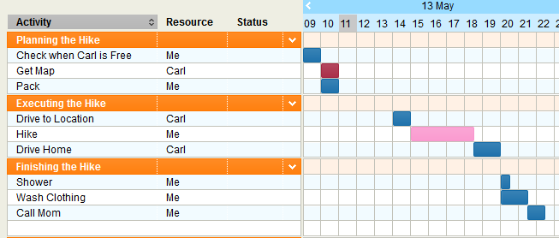
→Schedule

Slide 16
Sidenote on Making Gantt Charts
Use free option such as OpenProj
Simple online solutions (I used http://www.tomsplanner.com/ for the previous slides, others available)

Slide 17
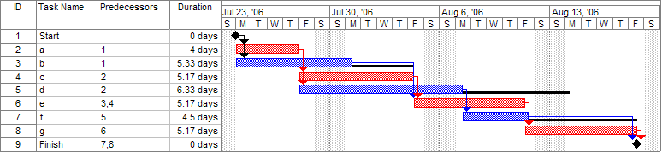
Critical Path
Source: http://en.wikipedia.org/wiki/Gantt_chart

Slide 18
Scheduling Notes
Your first schedules will be horribly wrong
Accept this, LEARN, and use it to improve future schedules
Consider scheduling for your robot – will be a big part of the plan
Scheduling will be a major part of your progress report and final report – so start thinking about it now!

Slide 19
Risk Management

Slide 20
Common Risks
Time & Cost estimates incorrect
Budget Changes
Change of Scope
Legal issues
Supplier issues

Slide 21
Common Risks
Time & Cost estimates incorrect
Project is more complicated than expected
Budget Changes
Project based on overall budget, then overall budget cut
Change of Scope
Not fully defined before starting project
Legal issues
We need special certifications, those cost $50k and take 6 months
Supplier issues
Part is on backorder with 14-week lead time, but when we designed the
system it was widely available.

Slide 22
Risk Management
Identify Risks
Analyze the risks
Prioritize the risks
Plan a risk response
Monitor the risks
Control the risks

Slide 23
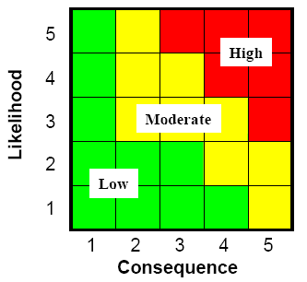
Risk Management

Slide 24
Example of Risk Management

Slide 25
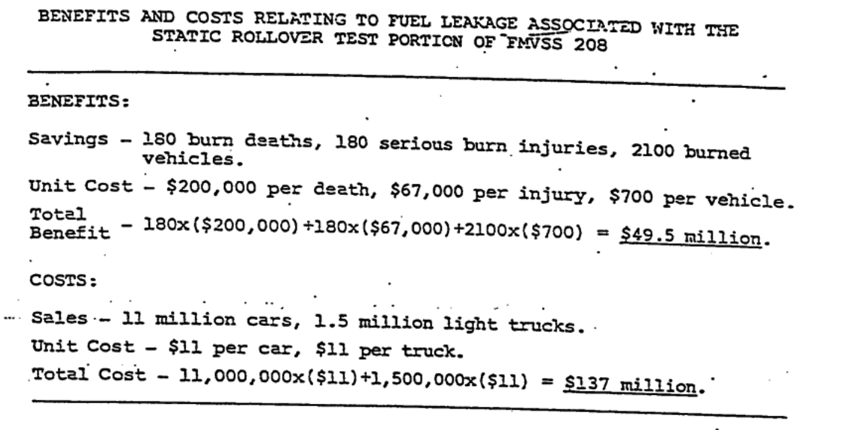
When Cost-Benefit runs awry..
http://www.autosafety.org/uploads/phpq3mJ7F_FordMemo.pdf

Slide 26
Patents
**THIS IS NOT LEGAL ADVICE. I AM NOT A LAWYER.**

Slide 27
Patents
Prevents someone else from selling a device which ‘infringes’ on your claims
Is *NOT* a license to sell the device, is possible your device still infringes on someone else's patent
Only enforceable in geographic area issued in (i.e. US, Canada, UK, China, etc.)
A patent is effectively a legal proceeding
The patent office (and later possibly a third party) is using standard legal procedure to reach a ‘verdict’
Your initial claims that will be examined are your patent application
**THIS IS NOT LEGAL ADVICE. I AM NOT A LAWYER.**

Slide 28
Reading a Patent
Important Sections:
1) Claims
2) Everything else
The ‘Claims’ is solely what is claimed as the innovative material.
The ‘Specification’ must detail how it works etc., and can restrict the claims. However lots of material written in the specification may be well-known already.
Prior art must read on the claims.
**THIS IS NOT LEGAL ADVICE. I AM NOT A LAWYER.**

Slide 29
Patent Application
A patent application IS NOT a patent
**THIS IS NOT LEGAL ADVICE. I AM NOT A LAWYER.**

Slide 30
Patent Application
Patent Application = I have $400 USD. That is all it means.
A patent application that is fairly likely to be enforceable is >$5 000 normally
Defending a patent can easily cost > $50 000, after which point it has more value
Failures in the original application might mean someone can easily circumvent your patent, lets see some examples:
**THIS IS NOT LEGAL ADVICE. I AM NOT A LAWYER.**

Slide 31
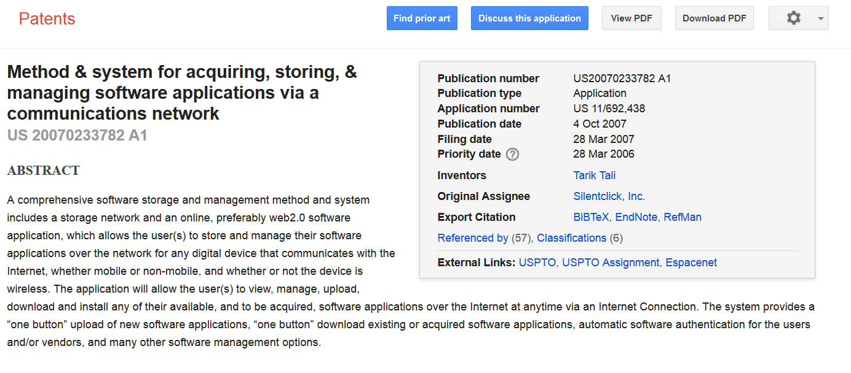
Example: Looking up a Patent
Patents.google.ca

Slide 32
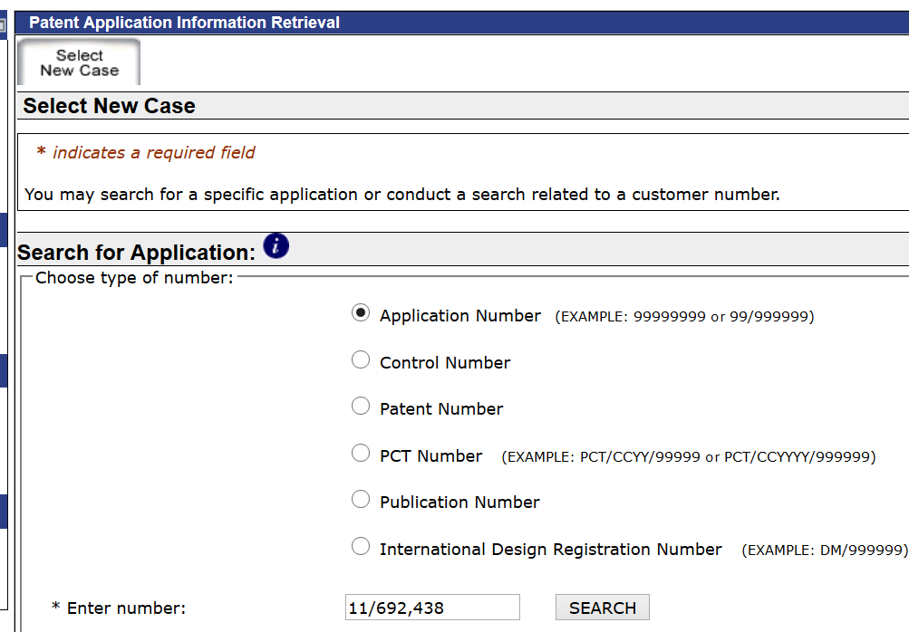
Example: Getting Patent Details
USPTO Public Pair
http://portal.uspto.gov/pair/PublicPair

Slide 33
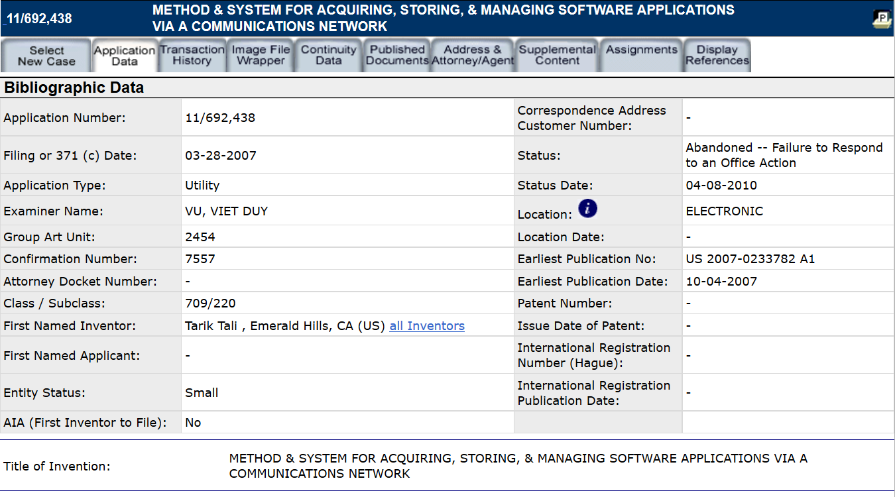
Examples: Getting Patent Details

Slide 34
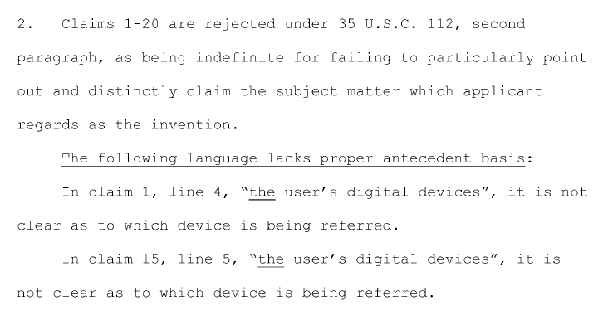
Examples: Getting Patent Details

Slide 35
EMC/Safety Tests

Slide 36
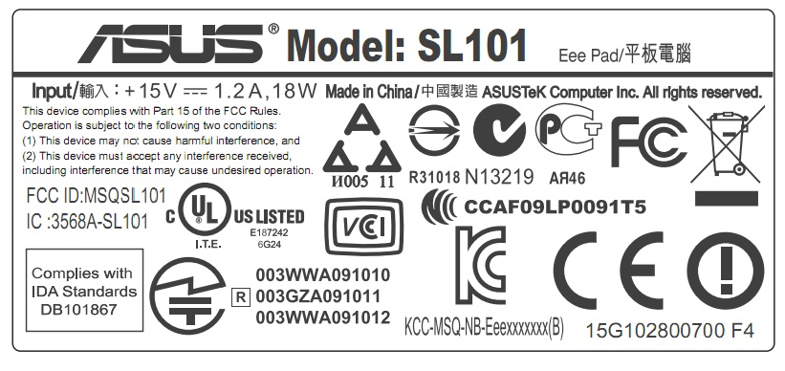
EMC Testing
Lots of these labels on devices:

Slide 37
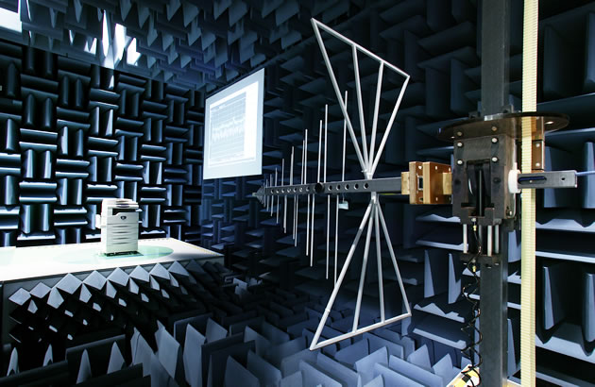
Testing
Getting these tests done is fairly expensive for a variety of reasons
i.e., EMC interference testing:
Source: http://www.fujixerox.co.jp/eng/company/headline/2005/0615_emc.html

Slide 38
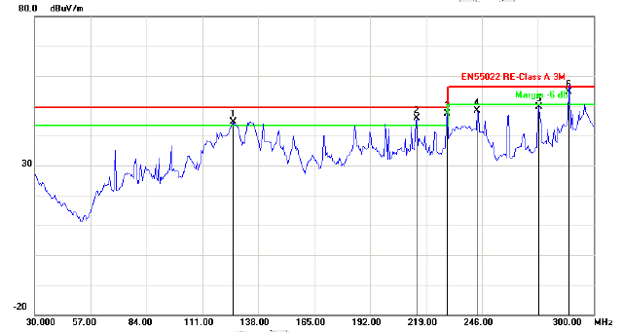
Example: Interference Test Report

Slide 39
Specialized Tests
Certain environments have additional tests required:
i.e. Aviation, mining, etc.

Slide 40
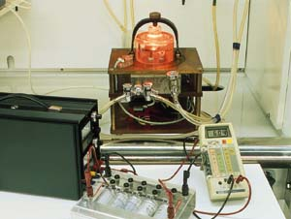
Example: Spark Test
Source: http://www.offshore-mag.com/articles/print/volume-56/issue-11/news/general-interest/directive-imposes-new-obligations-for-explosive-atmosphere-equipment.html

Slide 41
Summary
Scheduling a critical part of your project planning
Doesn’t need to be complex!
Write your tasks
Break them down until you can estimate each task size
String those broken down tasks together into a schedule
Try to avoid dependency as much as possible… your critical path is that which any delay in one subtask delays your entire project
Many risks facing your project – better to be prepared!
Patent Application is not a Patent

